Slide 1
Crime vs. Weather
By: Ryan Mccord and Anthony Alfano

Slide 2
Motivation and Questions
Motivation: We wanted a project dealing with human behavior
Questions:
What time of day does most crime occur?
What time of year does most crime occur?
Does crime vary based on time of year?
Is there a correlation between weather conditions and crime?
Is there a correlation between temperature and crime?

Slide 3
Summary of Results
The most criminal activity occurs between 3 PM and 1 AM
Crime goes up in the summer months
Slight correlation between suicide and weather
Heavy correlation between temperature and crime

Slide 4
Questions and Data
Kansas City crime data
Types of crime and time crimes occurred
Data provided by KCPD Information Technology
Kansas City weather data from Kaggle
Temperature
Conditions

Slide 5
Data Cleanup and Exploration
Kansas City crime data
Categorizing crime
Kansas City weather data
Date and time issues
Categorizing weather

Slide 6
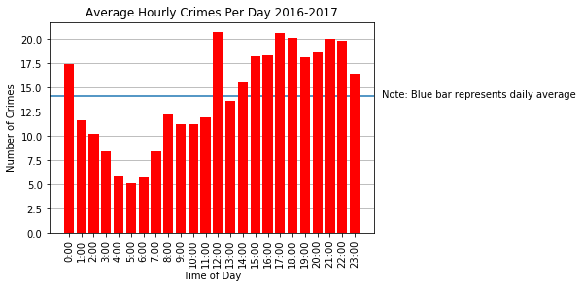
What time of day does most crime occur?

Slide 7
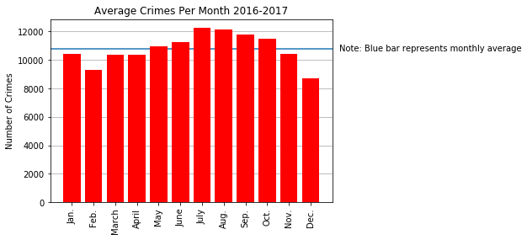
What time of year does most crime occur?

Slide 8
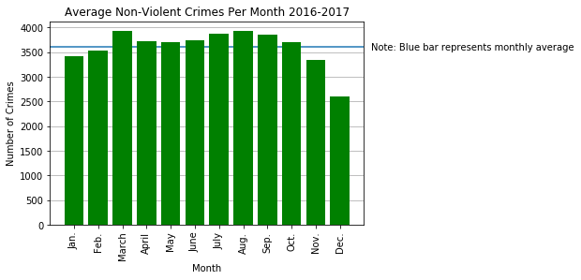
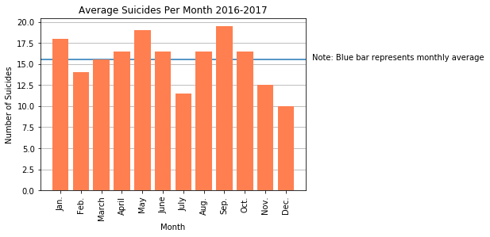
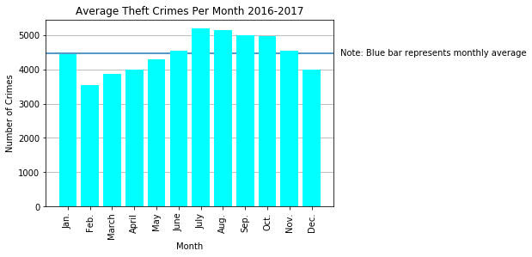
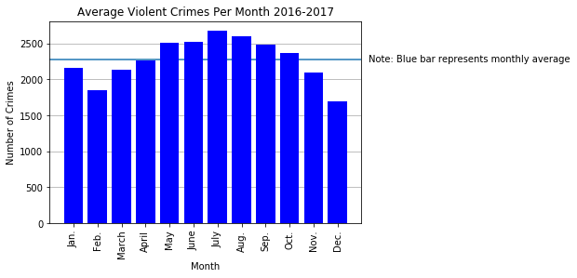
* Blue line represents monthly average

Slide 9
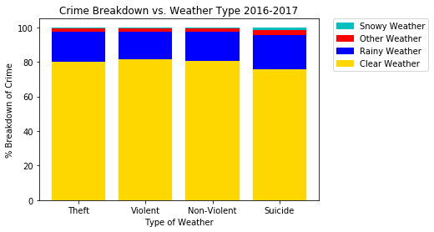
Is there a correlation between weather conditions and crime?

Slide 10
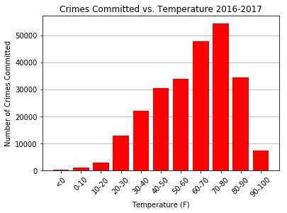
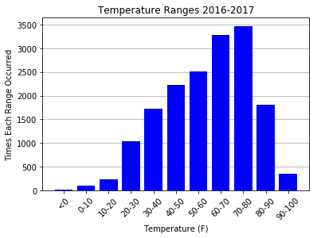
Is there a correlation between temperature and crime?

Slide 11
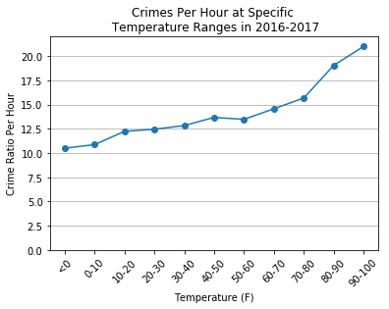
Temperature vs. crime continued

Slide 12
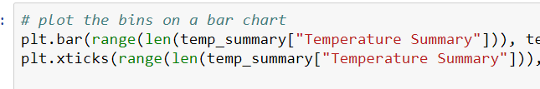
Post Mortem
Difficulties
Getting x ticks labeled appropriately
Additional questions?
Create a breakdown of type of crime by hour
Suicide rate
More cities and longer timeline

Slide 13
Questions?

